Slide 1
Exam PREP
James Jollymore
Learning strategist
CAASS
SAC 346
James.Jollymore1@msvu.ca

Slide 2

PLAN
Make a comprehensive to-do list.
Include all lectures, readings & assignments that will be covered.
Plan your study schedule based on your to-dos (and other priorities).

Slide 3

Understand Your Study Needs
What steps do I need to take to prepare?
How long will it take me to prepare?
What resources do I HAVE/NEED?
What hints have been given in class?
Reflect on previous evaluations:
  Will the exam be similar format/ questions as previous ones?
  Whole (cumulative) or part of semester?

Slide 4
Details | What do I Need to do to Prepare? | Time Estimate | Scheduled | Completed
Course Name: Intro to PSYC Test/Assignment: Final Exam Multiple Choice Due Date: April 20th Location: SAC 503 Test/Assignment is worth: 25% Priority: 1st | Review Chapters 1-9. | 3-5 hours | □ | □
 | Review lecture notes for weeks 6-13 | 2 hours | □ | □
 | Create and complete practice questions on key terms and main concepts | 2 hours | □ | □
 | Meet with study group to discuss key points and clarify information | 2 hours | □ | □
 | Complete practice questions at the end of each chapter & Self test | 2 hours | □ | □
Notes:
4

Slide 5
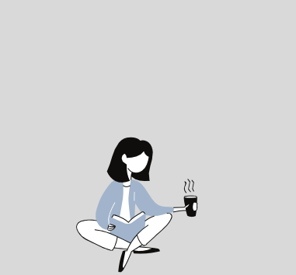

STUDYING AND TESTING
Study using multiple methods and ways of engaging in the information.
Practice like it's the exam! Mimic exam settings including time and materials available
Have a consistent study space. Have all your materials available and stay away from distractions

Slide 6
SQ3R
is a reading comprehension method named for its five steps: survey, question, read, recite, and review.
SURVEY
Read the title
Read the introduction and/or summary
Notice each heading and subheading
Notice any graphics / textboxes
QUESTION
Turn the heading for each section into as many questions as you think will be answered in that section. When your mind is actively searching for answers to questions it becomes engaged in learning. Be curious!

Slide 7
READ
Read one section at a time with your questions in mind and look for the answers. Recognize when you need to make up new questions.
RECITE
After each section, stop and recall your questions and see if you can answer them from memory. If not, look back at the text again (as often as necessary), but don’t move to the next section until you can recite the answers from the previous one.
REVIEW
Go back over the questions you created for each heading. See if you can still answer them. If not, look back and refresh your memory and then continue.

Slide 8
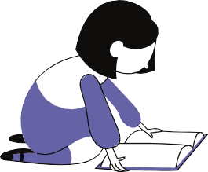


DAY OF THE EXAM
REVIEW
Go over your notes and review what you have covered. Now is not the time to be learning new things, but time to solidify what you already know.
RELAX
To perform your best you need to enter the exam calm. Take the time to breathe and relax.
You got this!
EXECUTE
Make a plan of action where you decide how much time to spend on each question. Take into account the value of each question, and your knowledge. Don't forget to plan in breaks!

Slide 9


AFTER THE EXAM
YOU DID IT!
Be proud of all you have accomplished. Plan something fun for after the exam and avoid students who just want to talk about the exam.
REVIEW YOUR EXAM
Review your graded exam so you can see where you went right and where you went wrong. Don't forget to check for grading mistakes!
REFLECT
Think back over your exam experience and ask yourself: What would I do the same? What would I change? Now is your time to learn from the experience and grow as a student.

Slide 10
General Strategies:
For M/C: Cover the answers and try to answer the question yourself first.
‘Brain-dump’: review the test and before answering any questions, take a scrap of paper and write down as many things you can recall about the topics.
Take your time – stop, close your eyes, and focus on your breathing for 10 seconds, to re-focus/re-centre yourself.
Notes:
Determine how much time you should spend on each question.
Check your watch regularly.
Know how far along you should be after 10 minutes, 20 minutes, etc.
It will take you only a few minutes to preview the test. It is important to know roughly how much time to spend on each questions so that you put the most effort into questions that are worth the most marks.

Slide 11
General Strategies:
Read the instructions carefully.
  Best answer?
  All correct answers?
  Looking for the one wrong item?
Consider the total number of questions and the time limit.
Go through the whole test once, in order.
  Answer the questions you’re sure of.
  Mark those you find difficult.
Return to the hard questions.
  Answer any that you are reasonably sure of.
Return to any unanswered questions.
  Make an educated guess.
Notes:
Determine how much time you should spend on each question.
Check your watch regularly.
Know how far along you should be after 10 minutes, 20 minutes, etc.
It will take you only a few minutes to preview the test. It is important to know roughly how much time to spend on each questions so that you put the most effort into questions that are worth the most marks.

Slide 12
Deciding between two similar answers
Reread the question & underline key words.
Make note of the differences between the answers.
Try to imagine each alternative as the answer.
As a last resort, make an educated guess.
Notes:
Strategies for guessing:
If the two alternatives are exact opposites, choose one of them.
If one alternative is longer, choose it.

Slide 13
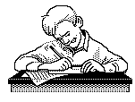
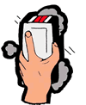
If you have time to go back over the test, should you change answers??
Yes… if you are fairly sure that the answer you chose is wrong.
No… if you are changing it because you noticed a pattern in your responses.

Slide 14

You’ve got this!
James Jollymore
Learning strategist
CAASS
SAC 346
James.Jollymore1@msvu.ca

